Slide 1

New strategies for finding failures and their domains
Mian Asbaat Ahmad
24-01-2013

Slide 2

Objectives
Development of new automated strategies with the following objectives:
To find the maximum number of faults and their domains
To use a minimum number of test calls
To take the least possible time
To require minimal resources
To give comprehensive results
To create an extensive test suite

Slide 3
Thesis contributions
Dirt Spot Sweeping Random (DSSR) Strategy
Automated Discovery of Failure Domain (ADFD) Strategy
ADFD with Daikon (ADFD-D) Strategy

Slide 4

Why random testing?
Because:
Testing of all values is typically impossible
Time and resources are limited
Easy to implement
Free from human bias
Quick and effective in finding faults

Slide 5
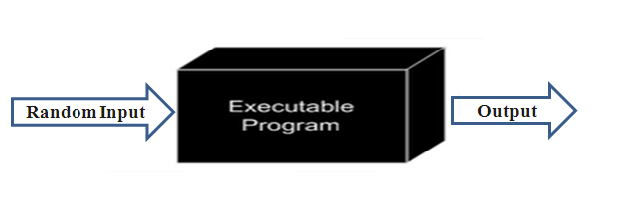
What is Random Testing?
Black-box testing technique
Dynamic testing process
Random Selection
Test execution
Output evaluation
Result generation

Slide 6

Automated Random Testing
Automation of the process for:
Analysis of system under test
Selection of test values
Execution of tests
Evaluation of results
Delivery of results
Generation of test suite

Slide 7
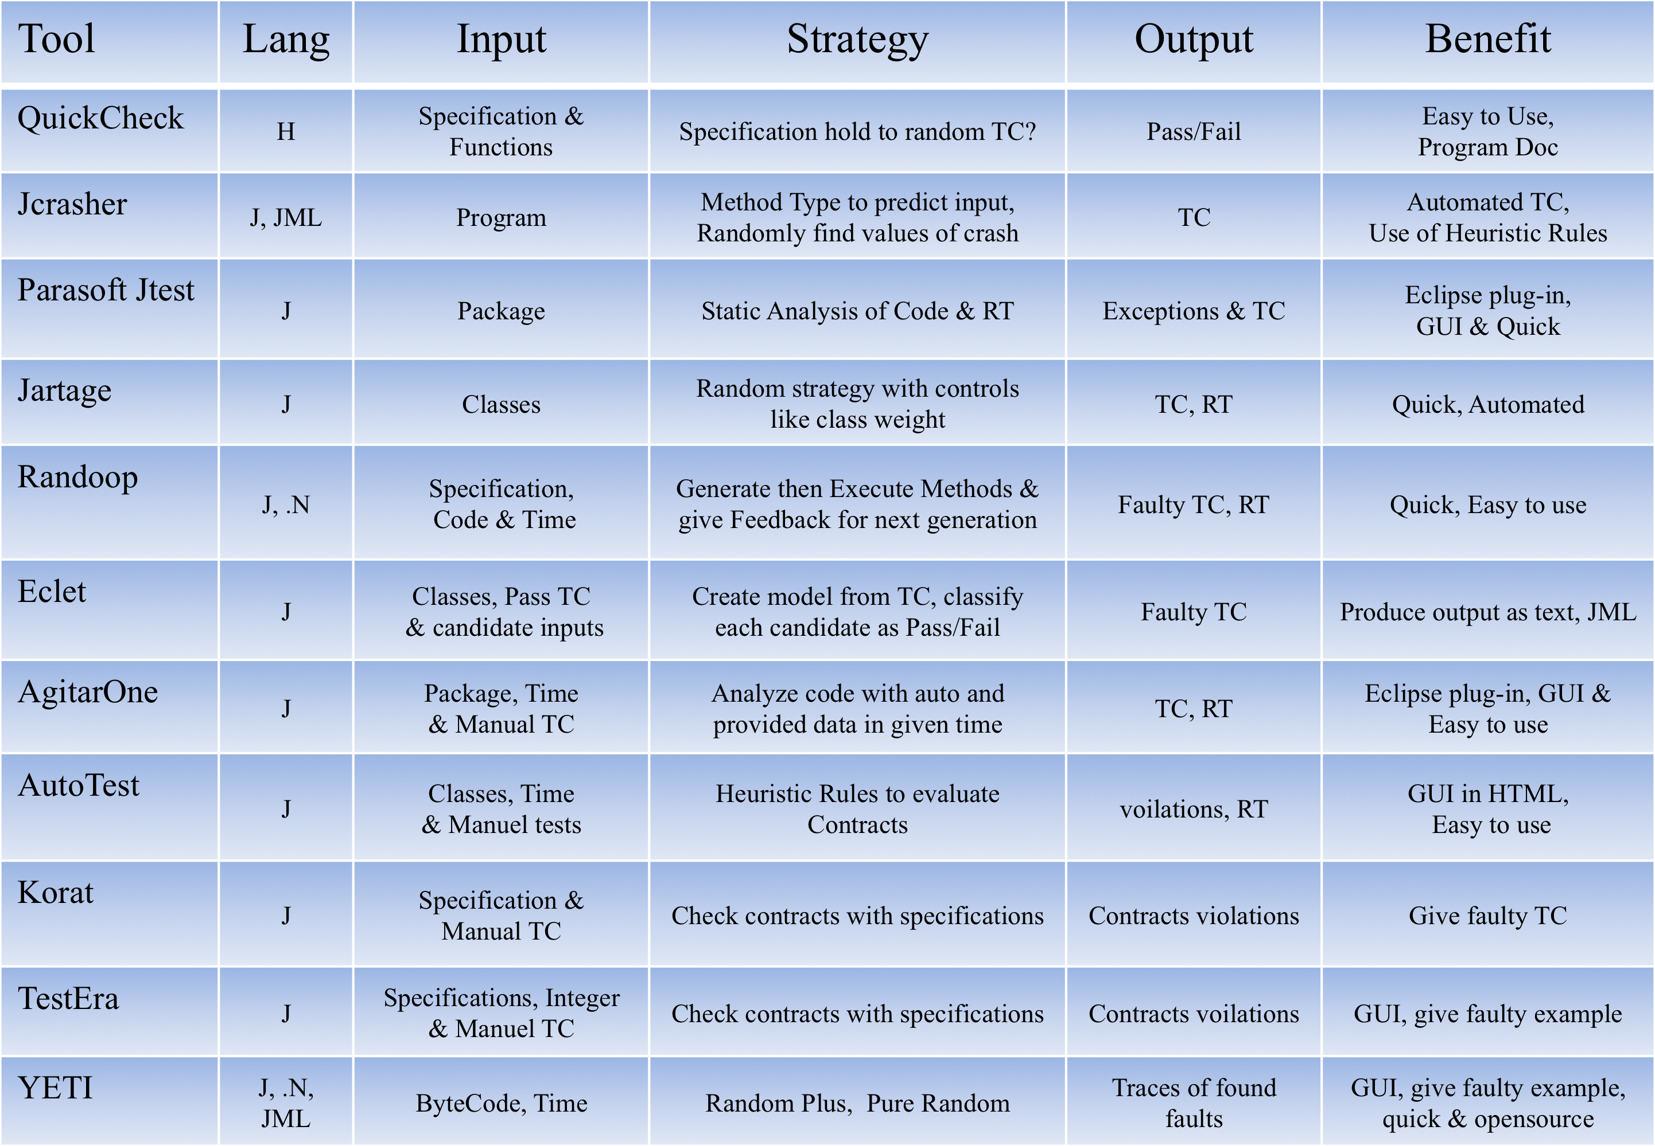
Automated Random Testing Tools

Slide 8
York Extensible Testing Infrastructure
Random testing tool
Developed in Java
Supports multiple languages
High speed (up to 10⁶ calls per minute)
Both CLI and GUI interfaces
Interactive testing
Experimentally verified
Runnable in cloud
Notes:
Yeti is a random testing tool, strategy used is random testing
Coded in Java
by testing java.lang and iText
Decoupling ?
Language agnostic ?
High speed of processing
Yeti can be operated from both CLI and GUI
Testing can be changed at run time

Slide 9
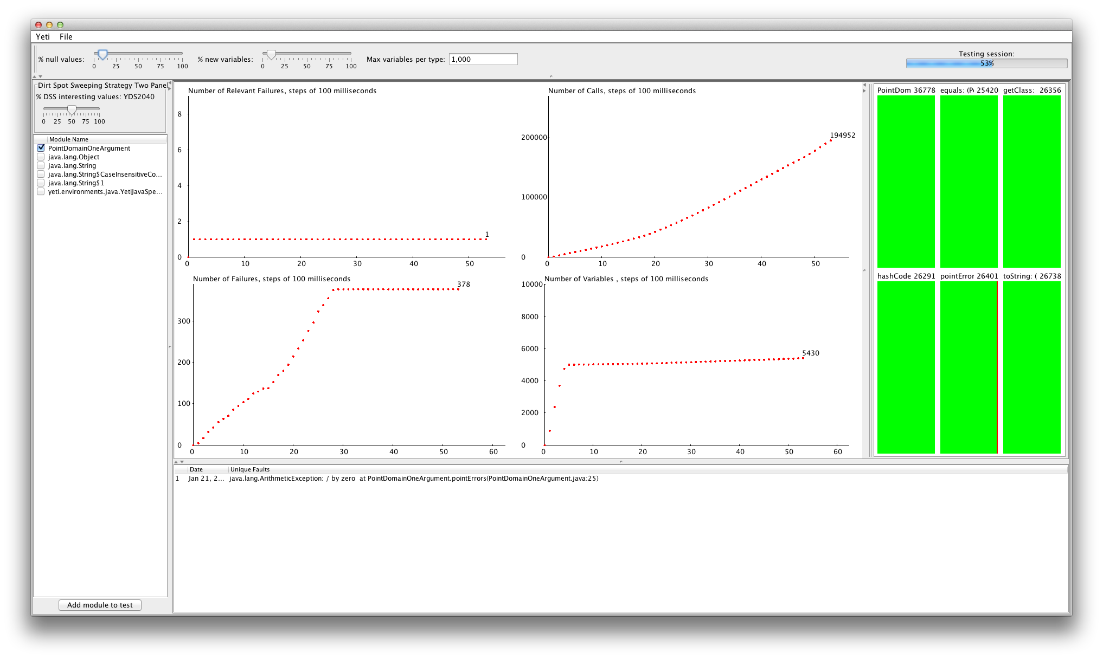
YETI Front-end

Slide 10
Why Improve Random Testing?
To increase code coverage
If(x == 3333) then … where x is 32 bit variable
To increase efficiency
To decrease over-head
To generate friendly output
To introduce automation

Slide 11
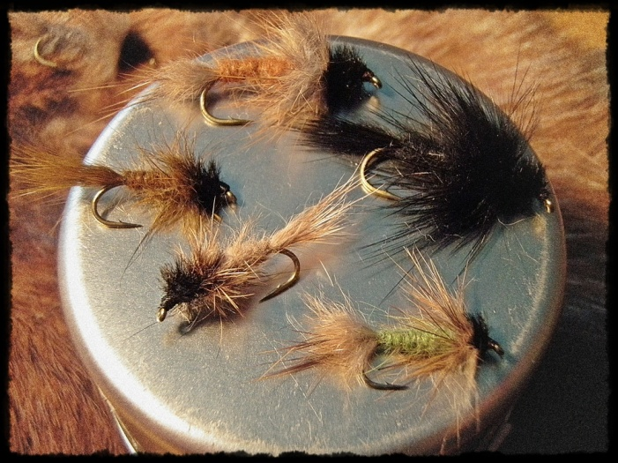
Enhanced versions of Random Testing
Adaptive Random Testing (ART)
Quasi Random Testing (QRT)
Mirror Adaptive Random Testing (MART)
Restricted Random Testing (RRT)
Feedback-Directed Random Testing (F-DRT)
Random Plus Testing (R+)

Slide 12
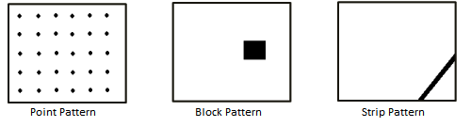
Types of Fault Domain
Point Fault Domain
Faults lies scattered across input domain
Block Fault Domain
Faults lies in a block across input domain
Strip Fault Domain
Faults lies in a strip across the input domain

Slide 13
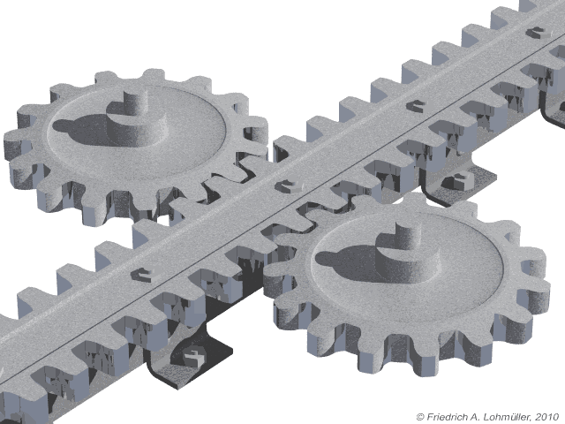
Main idea of DSSR
We start by testing with YETI (using random+)
When a new failure is found we add the neighboring values to the list of interesting values
These have higher priority, effectively sweeping around the faults found

Slide 14
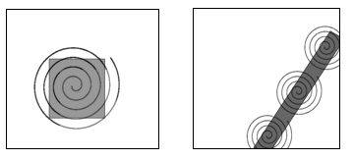
Dirt Spot Sweeping Random Strategy
Based on three strategies
Random
Random Plus
Spot Sweeping
Block sweeping
Strip sweeping

Slide 15
Example to illustrate DSSR strategy
/**
* Calculate square of given number and verify results.
* The code contain 3 faults.
* @author (Mian and Manuel)
*/
public class Math1{
public void calc (int num1) {
// Square num1 and store result.
int result1 = num1 * num1;
int result2 = result1 / num1; // 1
assert Math.sqrt(result1) == num1; // 2
assert result1 >= num1; // 3
}
}

Slide 16
Performance of DSSR compared to R and R+ St.
60 classes from 32 projects were tested by R, R+ and DSSR strategies
In 43 classes all three strategies found the same number of faults
In remaining 17 classes DSSR strategy found the highest number of unique failures (1117) followed by R+ (1106) and R (1090) respectively
On overall basis DSSR strategy performed better than R and R+ strategies

Slide 17
Test Results of 17/60 classes
DSSR strategy better up to 33% than R, up to 17% than R+

Slide 18
Limitations of DSSR strategy
Lack of improvement in point fault domain
Excess time involved to find first fault
5% over-head than R and 2% than R+ in execution

Slide 19
Automated Discovery of Failure Domain (ADFD)
A new automated strategy implemented in YETI
Provides GUI interface
Facilitates control on lower and upper bound
Finds faults and their domains
Presents results in graphical form

Slide 20
Main idea of ADFD
We start by testing with YETI (using random+)
When a new failure is found ADFD generates programs that will test each direction independently
We then compile and execute these programs
They generate failure domains for each direction
We show the results in the interface

Slide 21
Using ADFD
Launch the ADFD application
Select language, ADFD strategy and time
Select class for Testing
Specify lower and upper bounds
Click run button to start testing
Program is dynamically generated
Click count button to find number of files generated
Click button to compile the program
Click button to execute the program
Data is generated
Click button to plot graph

Slide 22
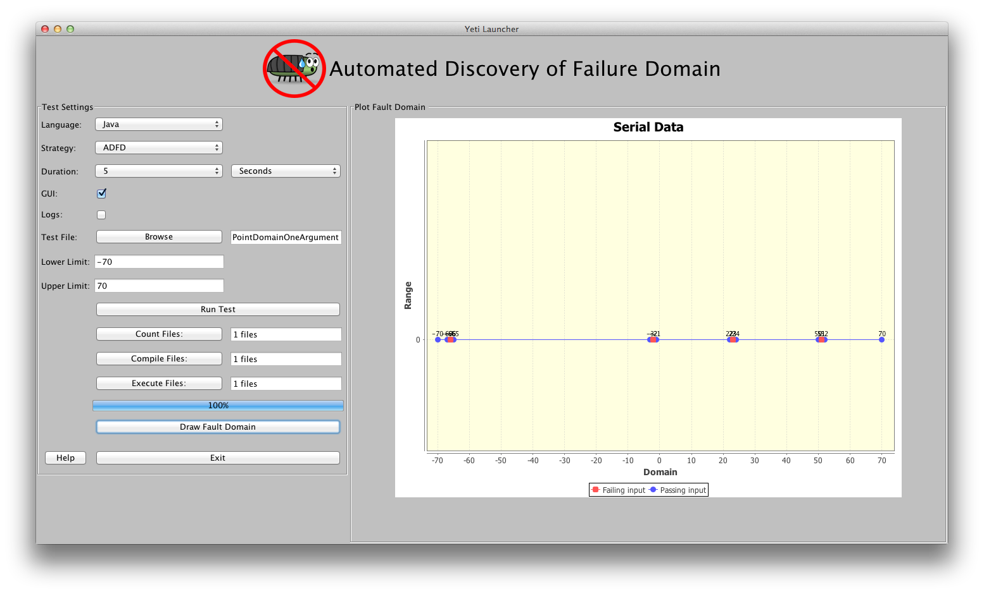
Front-end of ADFD

Slide 23
Illustration of ADFD strategy by examples of Point, Block and Strip Fault Domains

Slide 24
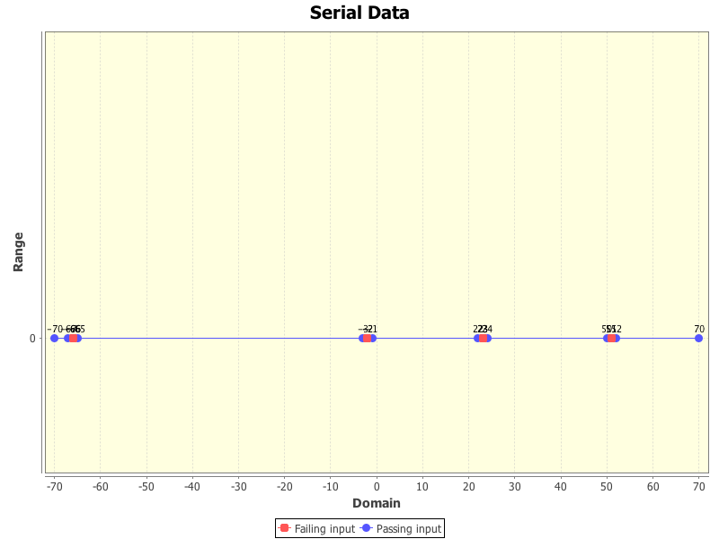
Point Fault Domain one Argument
/**
* Point Fault Domain example for one argument
* @author (Mian and Manuel)
*/
public class PointDomainOneArgument{
public static void pointErrors (int x){
if (x == -66 )
abort();
if (x == -2 )
abort();
if (x == 51 )
abort();
if (x == 23 )
abort();
}
}

Slide 25
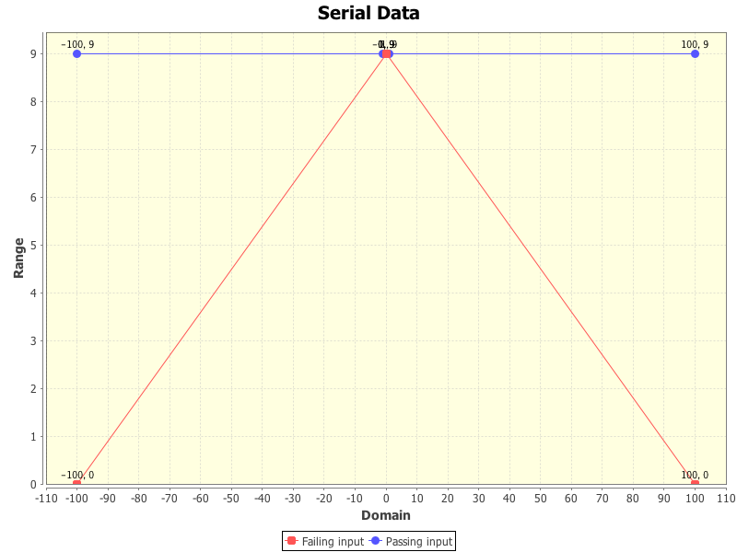
Point Fault Domain two Argument
/**
* Point Fault Domain example for two arguments
* @author (Mian and Manuel)
*/
public class PointDomainOneArgument{
public static void pointErrors (int x, int y){
int z = x/y;
}
}

Slide 26
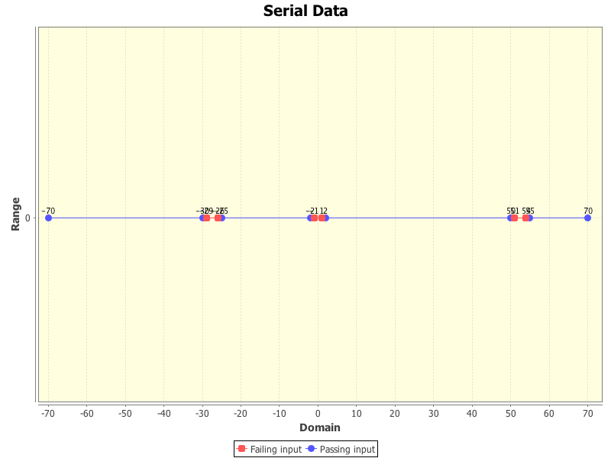
Block Fault Domain one argument
/**
* Block Fault Domain example for one argument
* @author (Mian and Manuel)
*/
public class BlockDomainOneArgument{
public static void blockErrors (int x){
if((x > -2) && (x < 2))
abort();
if((x > -30) && (x < -25))
abort();
if((x > 50) && (x < 55))
abort();
}
}

Slide 27
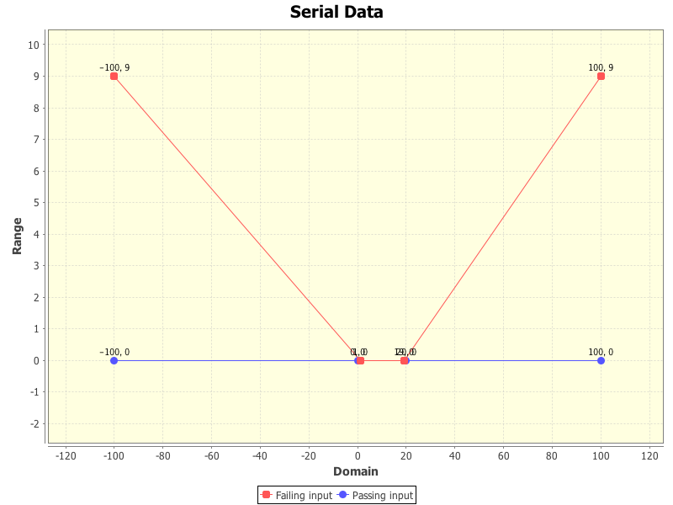
Block Fault Domain two argument
/**
* Block Fault Domain example for two arguments
* @author (Mian and Manuel)
*/
public class BlockDomainTwoArgument{
public static void pointErrors (int x, int y){
if(((x > 0)&&(x < 20)) || ((y > 0) && (y < 20))){
abort();
}
}
}

Slide 28
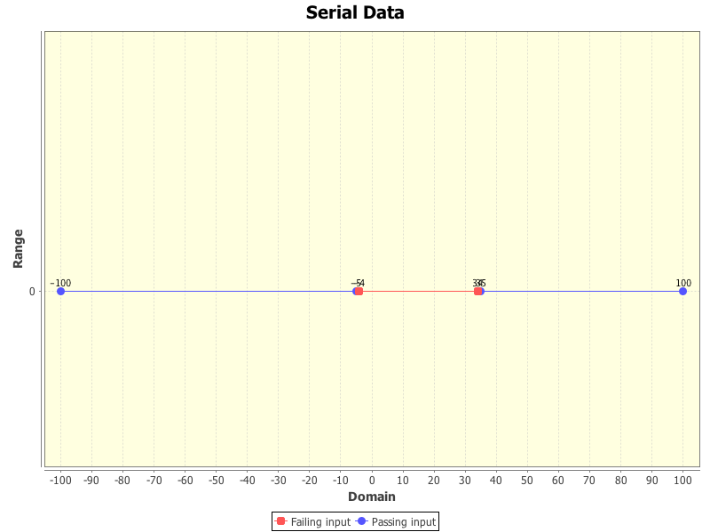
Strip Fault Domain one argument
/**
* Strip Fault Domain example for one argument
* @author (Mian and Manuel)
*/
public class StripDomainOneArgument{
public static void stripErrors (int x){
if((x > -5) && (x < 35))
abort();
}
}

Slide 29
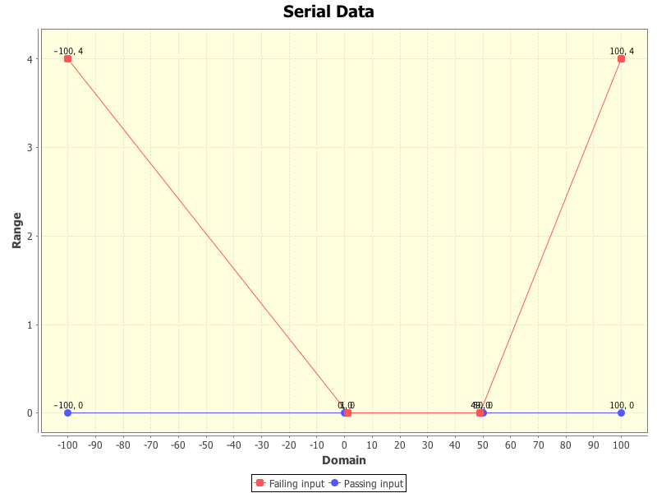
Strip Fault Domain two argument
/**
* Strip Fault Domain example for two arguments
* @author (Mian and Manuel)
*/
public class StripDomainTwoArgument{
public static void pointErrors (int x, int y){
if(((x > 0)&&(x < 50)) || ((y > 0) && (y < 500))){
abort();
}
}
}

Slide 30
Development of ADFD with Daikon (ADFD-D) strategy
Salient Features
To execute SUT by Daikon to generate invariants
To add values from invariants to the list of interesting values
To Execute DSSR strategy

Slide 31
Daikon Invariant Detector
Automated tool
Developed by MIT Program Analysis Group
Dynamically reports likely program invariants
Detect C, C++, Eiffel, IOA, Java and Perl programs.
freely available: http://groups.csail.mit.edu/pag/daikon/download/

Slide 32
Daikon with ADFD strategy
We are utilizing Daikon invariants:
As oracle for comparing test results
To find border (interesting) values
To remove the dependence of DSSR on R+ strategy
To increase test performance by restricting the upper and lower bound.

Slide 33
Conclusions
Dirt Spot Sweeping Random (DSSR) Strategy
Up to 33% better compared to R strategy
Up to 17% better compared to R+ strategy
Automated Discovery of Failure Domain (ADFD) Strategy
Finds and Plots fault domain
Exhaustive search of projections on each axis
ADFD with Daikon (ADFD-D) Strategy
Combination of ADFD strategy with Daikon
Research still in Progress

Slide 34
Thank You

